Slide 1
Software Engineering
Ref. book :
Software Engineering by Roger Pressman

Slide 2
Chapter : Topic Covered
Evolving Role of Software
Hardware vs. Software
Software characteristics
Changing nature of software
Evolution of Software
Software Myths

Slide 3
Evolving Role of Software
Software is a product
Transforms information - produces, manages, acquires, modifies, displays, or transmits information
Delivers computing potential of hardware and networks
Software is a vehicle for delivering a product
Controls other programs (operating system)
Effects communications (networking software)
Helps build other software (software tools & environments)

Slide 4
What is Software ?
Software can define as:
Instruction – executed provide desire features, function & performance.
Data structure – to adequately manipulate operation.
Documents – operation and use of the program.
Software products may be developed for a particular customer or may be developed for a general market.
Software products may be
Generic - developed to be sold to a range of different customers e.g. PC software such as Excel or Word.
Bespoke (custom) - developed for a single customer according to their specification.

Slide 5
Hardware vs. Software
Hardware | Software
Manufactured wear out Built using components Relatively simple | Developed/ engineered deteriorate Custom built Complex

Slide 6
Manufacturing vs. Development
Once a hardware product has been manufactured, it is difficult or impossible to modify. In contrast, software products are routinely modified and upgraded.
In hardware, hiring more people allows you to accomplish more work, but the same does not necessarily hold true in software engineering.
Unlike hardware, software costs are concentrated in design rather than production.

Slide 7
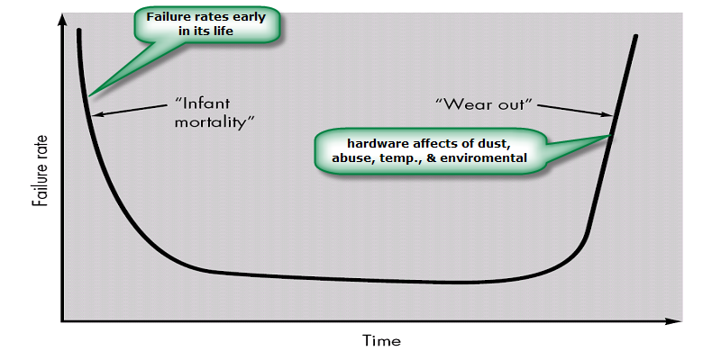
Failure curve for Hardware

Slide 8
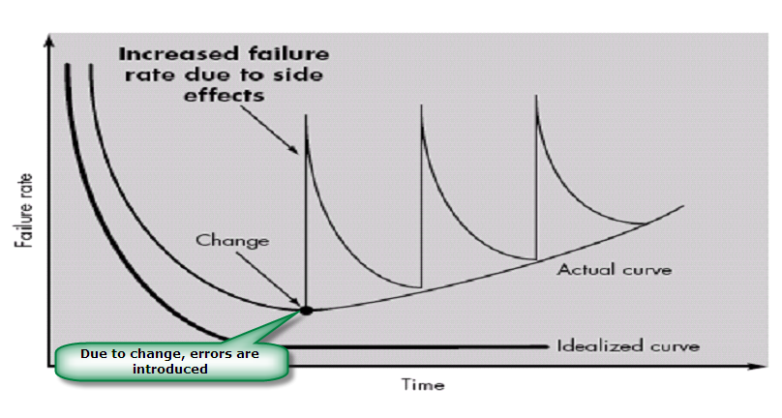
Failure curve for Software
When a hardware component wears out, it is replaced by a spare part. There are no software spare parts. Every software failure indicates an error in design or in the process through which design was translated into machine executable code. Therefore, software maintenance involves considerably more complexity

Slide 9
Component Based vs. Custom Built
Hardware products typically employ many standardized design components.
Most software continues to be custom built.
The software industry does seem to be moving (slowly) toward component-based construction.

Slide 10
Software characteristics
Software is developed or engineered; it is not manufactured.
Software does not “wear out” but it does deteriorate.
Software continues to be custom built, as industry is moving toward component based construction.
Intangible

Slide 11
Concept of Modern Software
Modern software is integration of
programs that execute for accomplishment of a task
data on which the programs operate
configuration files
application data
documentations to describe the software
Training Material
Reference Guides
Development and support documents
Help Manuals
installation guide, operation guides, maintenance & support guides

Slide 12
Classification of Software
Based on Application
System Software
Programming Software
Application Software
Administrative Software
Based on Distribution
Customized Software and Market Software
Retail Software
Freeware, Shareware, Demo ware
Open Source Software
…

Slide 13
System Software:
System software is a collection of programs written to service other programs.
It is characterized by heavy interaction with computer hardware; heavy usage by multiple users; concurrent operation that requires scheduling, resource sharing, and sophisticated process management; complex data structures; and multiple external interfaces.
Ex. Compilers, operating system, drivers etc.
Application Software :
Application software consists of standalone programs that solve a specific business need.
Application software is used to control the business function in real-time.
Engineering /Scientific software:
Characterized by "number crunching" algorithms.
Applications range from astronomy to volcano logy, from automotive stress analysis to space shuttle orbital dynamics, and from molecular biology to automated manufacturing.
Ex. Computer Aided Design (CAD), system stimulation etc.

Slide 14
Embedded Software:
It resides in read-only memory and is used to control products and systems
Embedded software can perform limited and esoteric functions.
Ex. keypad control for a microwave oven.
Product line software:
Designed to provide a specific capability for use by many different customers, product line software can focus on a limited and esoteric marketplace.
Ex. Word processing, spreadsheet, CG, multimedia, etc.
Web Applications:
Web apps can be little more than a set of linked hypertext files.
It evolving into sophisticated computing environments that not only provide standalone features, functions but also integrated with corporate database and business applications.
Artificial Intelligence software
AI software makes use of non-numerical algorithms to solve complex problems that are not amenable to computation or straightforward analysis
Ex. Robotics, expert system, game playing, etc.

Slide 15
Software Engineering
IEEE defines Software Engineering as
application of systematic, disciplined, quantifiable approach to the development, operation and maintenance of software i.e. application of engineering to software and
the study of approaches as in.
Establishment and use of sound engineering principles in order to obtain reliable and efficient software economically.

Slide 16
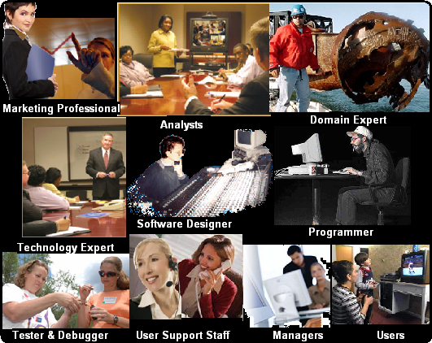
People in Software Engineering

Slide 17
Software Engineer’s Challenges
Overshooting Budgets
Schedule Deviations
Changing requirements
Implementing unclear requirements
Configuration Management
Unavailability of universal tools, techniques and methods

Slide 18
Software Myths
Myth1: If we get behind schedule, we can add more programmers and catch up
Reality: Software development is not a mechanistic process like manufacturing. Adding people to a late software project makes it later.
People can be added but only in a planned and well-coordinated manner
Myth2: If I decide to outsource the software project to a third party, I can just relax and let that firm build it.
Reality: If an organization does not understand how to manage and control software projects internally, it will invariably struggle when it outsource software projects

Slide 19
Customer Myths
Customer may be a person from inside or outside the company that has requested software under contract.
Myth: A general statement of objectives is sufficient to begin writing programs— we can fill in the details later.
Reality: A poor up-front definition is the major cause of failed software efforts. A formal and detailed description of the information domain, function, behavior, performance, interfaces, design constraints, and validation criteria is essential. These characteristics can be determined only after thorough communication between customer and developer.
Myth: Project requirements continually change, but change can be easily accommodated because software is flexible.
Reality: Customer can review requirements and recommend modifications with relatively little impact on cost. When changes are requested during software design, the cost impact grows rapidly. Below mentioned figure for reference.

Slide 20
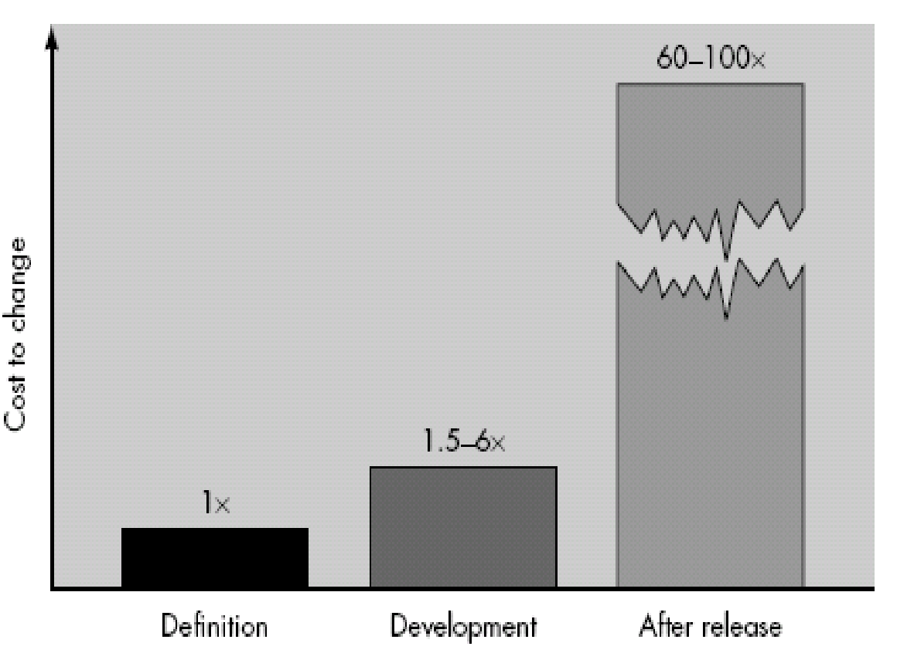

Slide 21
Practitioner's myths
Myth1: Once we write the program and get it to work, our job is done.
Reality: Someone once said that "the sooner you begin 'writing code', the longer it'll take you to get done." Industry data indicate that between 60 and 80 percent of all effort expended on software will be expended after it is delivered to the customer for the first time.

Slide 22
Software engineering is not about creating documents. It is about creating quality. Better quality leads to reduced rework. And reduced rework results in faster delivery times.

Slide 23
Summary
Software is an important integrated part of modern computers and automated systems. It usually consumes more that 70% of the total cost of the system. Software components are widely different from hardware. They do not get aged with their continuous use but get outdated with changing technology. Software components are custom made hence termed as ‘developed’ and not ‘manufactured’. Software is an integration of programs, data structure and documents. Software Engineering involves different people with their diversified roles in software development process. They include software users, domain experts, analysts, technology experts, designers, programmers, software testers, and support staff. Software engineering suffers a huge number of myths about software development procedures and causes of failures. High costs of development, slips of schedules, management controls over technical aspects and customer satisfaction are some of the major challenges for software developing organization. Software engineers, like any professional, should follow set codes of ethics in their work and deliverables.

